Slide 1
Credit Management
Presented by [Name]

Slide 2
Credit Management
While business firms would like to sell on cash, the pressure of competition and the force of custom persuades them to sell on credit.
Firms grant credit to facilitate sales.

Slide 3
Credit Policy
The important dimensions of a firm’s credit policy are:
Credit standards
Credit period
Cash discount
Collection effort
These variables are related and have a bearing on the level of sales, bad debt loss, discounts taken by customers, and collection expenses.

Slide 4
Credit Standards
Credit standards are the criteria which a firm follows in selecting customers for the purpose of credit extension.
The firm may have tight credit standards; that is, it may sell mostly on cash basis, and may extend credit only to the most reliable and financially strong customers.
Such standards will result in no bad-debt losses, and less cost of credit administration.

Slide 5
Conti….
To estimate the probability of default, the financial or credit manager should consider three C ’s:
character,
capacity
condition.

Slide 6
Conti…
The firm may categorize its customers, at least, in the following three categories:
Good accounts; that is, financially strong customers.
Bad accounts; that is, financially very weak, high risk customers.
Marginal accounts; that is, customers with moderate financial health and risk (falling between good and bad accounts).

Slide 7
Credit Period
The credit period refers to the length of time customers are allowed to pay for their purchases.
It generally varies from 15 days to 60 days.
When a firm does not extend any credit, the credit period would obviously be zero

Slide 8
Cash Discount
Firms generally offer cash discounts to induce customers to make prompt payments.
The percentage discount and the period during which it is available are reflected in the credit terms.
For example, credit terms of 2/10, net 30 mean that a discount of 2 percent is offered if the payment is made by the tenth day; otherwise the full payment is due by the thirtieth day

Slide 9
Collection Effort
The collection programme of the firm, aimed at timely collection of receivables, may consist of the following:
Monitoring the state of receivables
Dispatch of letters to customers whose due date is approaching
E-mail and telephonic advice to customers around the due date
Threat of legal action to overdue accounts
Legal action against overdue accounts

Slide 10
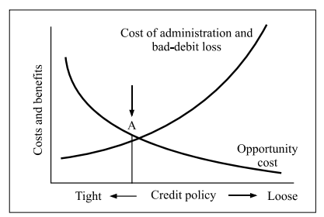
Optimum Credit Policy

Slide 11

where
ΔRI is the change in residual income,
ΔS is the increase in sales,
V is the ratio of variable costs to sales,
bn is the bad debt loss ratio on new sales,
t is the corporate tax rate,
k is the post-tax cost of capital, and
ΔI is the increase in receivables investment

Slide 12
Example
The present sales of Lamp & Light are Rs. 50 million. The firm categorizes its customers into three categories of providing credit: X, Y, and Z. It provides unlimited credit to customers in category X, limited credit to customers in category Y, and no credit to customers in category Z. Due to this credit policy, the firm is foregoing sales to the extent of Rs. 2.5 million to customers in category Y and Rs. 5 million to customers in category Z. The firm is considering the adoption of a more liberal credit policy under which customers in category Y would be extended unlimited credit policy and customers in category Z would be provided limited credit. Such relaxation would increase the sales by Rs. 5 million on which bad debt losses would be 4 percent. The contribution margin ratio for the firm is 10 percent, the average collection period is 40 days, and the cost of capital is 12 percent. The tax rate for the firm is 40 percent. What will be the effect of relaxing the credit policy on the residual income of the firm?

